Slide 1
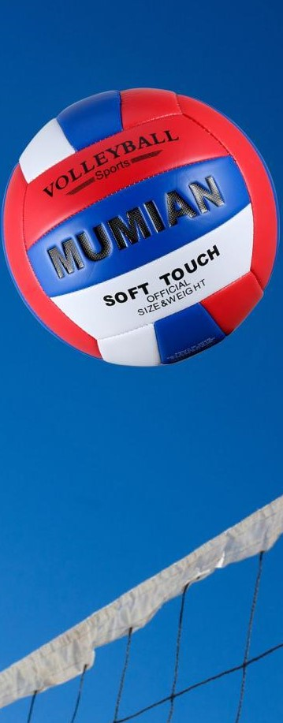
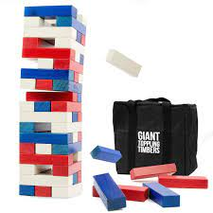
Westside High School
Feb.6-10 Week At a Glance (WAG)

Slide 2
Coach Thomas
Rec. Games: Feb.6-10

Slide 3
Monday - Agenda
Learning Target
I can use proper technique for stretching
I can use strategy to compete in relay while also working as a team
Feb. 6
Standard:
Opening ( 10-15 mins)
Student will go through stretches with coaches' lead
Work-session ( 20 - 25 mins)
Review of station/circuit exercises & students will go 30 seconds for each station
2. Coach will explain rules of speed ball (mix of basketball, soccer, and football)
(those not participating will walk)
Criteria for Success
1. Students can use proper technique to perform exercises
Closing ( 05 – 10 mins)
Cool down

Slide 4
Tuesday - Agenda
Learning Target
Feb. 7 Standard:
PERG.1 The physically educated student demonstrates competency in a variety of motor skills and movement patterns.
a. Demonstrates competence while performing skills in a variety of recreational game settings and activities
b. Performs skills at a level of competence, which contributes to health-related fitness.
c. Demonstrates proper warm-up and cool-down protocol associated with different life time
sport physical activities.
PERG. 2 The physically educated student applies the knowledge of concepts, principles, strategies, and tactics related to movement and performance.
Integrates a variety of strategies, tactics, concepts, and skills during recreational games activities
Evaluates skills needed for recreational games and leisure activities
PERG.3 The physically educated student demonstrates knowledge and skills to help achieve
and maintain a health-enhancing level of physical activity and fitness.
a. Maintains or improves fitness level by using the results of the Georgia Fitness Assessment
to guide changes in a personal program of physical activity.
b. Uses technologies to assess, enhance, and maintain health-related and skill-related fitness.
c. Analyzes the relationship between physical activity and longevity.
Personal and Social Behavior, Rules, Safety, and Etiquette
I can use the proper techniques to do the following
-stretch, complete circuit exercises,
2. I can compete as a team and follow game rules of speed ball
Opening ( 10-15 mins)
5-10 minute static & dynamic stretches (5 minutes locker rooms)
Work-session ( 20 - 25 mins)
30 seconds each exercise circuit
Teacher will provide rules of speed ball and students will work together as teams to compete
Criteria for Success
Students are able to use team strategy to compete in game of speed ball
Closing ( 05 – 10 mins)
locker room unlocked for 5 minutes
-students use remaining time to cool down & rehydrate if necessary

Slide 5
Wednesday - Agenda
Learning Target
Feb. 8 Standard:
PERG.1 The physically educated student demonstrates competency in a variety of motor skills and movement patterns.
a. Demonstrates competence while performing skills in a variety of recreational game settings and activities
b. Performs skills at a level of competence, which contributes to health-related fitness.
c. Demonstrates proper warm-up and cool-down protocol associated with different life time
sport physical activities.
PERG. 2 The physically educated student applies the knowledge of concepts, principles, strategies, and tactics related to movement and performance.
Integrates a variety of strategies, tactics, concepts, and skills during recreational games activities
Evaluates skills needed for recreational games and leisure activities
PERG.3 The physically educated student demonstrates knowledge and skills to help achieve
and maintain a health-enhancing level of physical activity and fitness.
a. Maintains or improves fitness level by using the results of the Georgia Fitness Assessment
to guide changes in a personal program of physical activity.
b. Uses technologies to assess, enhance, and maintain health-related and skill-related fitness.
c. Analyzes the relationship between physical activity and longevity.
Personal and Social Behavior, Rules, Safety, and Etiquette
1. I can demonstrate my understanding of speedball
2. I can work with teammates to compete in dodgeball by following rules and using various strategies
Opening ( 10-15 mins)
10 minute Walk & Attendance
Work-session ( 20 - 25 mins)
Speed Ball assessment
Dodgeball Review
Students will compete in best 2 out of 3 dodgeball
Criteria for Success
Closing ( 05 – 10 mins)
Students can explain how to play speed ball including the rules.
Students can work with peers to participate in dodgeball
-locker room unlocked for 5 minutes
-students use remaining time to cool down & rehydrate if necessary

Slide 6
Thursday - Agenda
Learning Target
Same as previous day
Feb. 9 Standard:
PERG.1 The physically educated student demonstrates competency in a variety of motor skills and movement patterns.
a. Demonstrates competence while performing skills in a variety of recreational game settings and activities
b. Performs skills at a level of competence, which contributes to health-related fitness.
c. Demonstrates proper warm-up and cool-down protocol associated with different life time
sport physical activities.
PERG. 2 The physically educated student applies the knowledge of concepts, principles, strategies, and tactics related to movement and performance.
Integrates a variety of strategies, tactics, concepts, and skills during recreational games activities
Evaluates skills needed for recreational games and leisure activities
PERG.3 The physically educated student demonstrates knowledge and skills to help achieve
and maintain a health-enhancing level of physical activity and fitness.
a. Maintains or improves fitness level by using the results of the Georgia Fitness Assessment
to guide changes in a personal program of physical activity.
b. Uses technologies to assess, enhance, and maintain health-related and skill-related fitness.
c. Analyzes the relationship between physical activity and longevity.
Personal and Social Behavior, Rules, Safety, and Etiquette
Opening ( 10-15 mins)
Static & Dynamic stretching
Work-session ( 20 - 25 mins)
Same as previous day
Criteria for Success
Closing ( 05 – 10 mins)
Same as previous day
-locker room unlocked for 5 minutes
-students use remaining time to cool down & rehydrate if necessary

Slide 7
Friday - Agenda
Learning Target
Feb. 10 Standard:
PERG.1 The physically educated student demonstrates competency in a variety of motor skills and movement patterns.
a. Demonstrates competence while performing skills in a variety of recreational game settings and activities
b. Performs skills at a level of competence, which contributes to health-related fitness.
c. Demonstrates proper warm-up and cool-down protocol associated with different life time
sport physical activities.
PERG.3 The physically educated student demonstrates knowledge and skills to help achieve
and maintain a health-enhancing level of physical activity and fitness.
a. Maintains or improves fitness level by using the results of the Georgia Fitness Assessment
to guide changes in a personal program of physical activity.
b. Uses technologies to assess, enhance, and maintain health-related and skill-related fitness.
c. Analyzes the relationship between physical activity and longevity.
Personal and Social Behavior, Rules, Safety, and Etiquette
Freestyle Friday
Opening ( 10-15 mins)
Attendance
Work-session ( 20 - 25 mins)
Students are able to engage in various activities/sports typically those that they are most interested
Teacher will conference will students and possibly make parent phone calls/contact as needed
Criteria for Success
I can demonstrate my understanding of the rules, procedures, and expectations by following them during class time and asking questions to teacher if necessary.
Closing ( 05 – 10 mins)
N/A

Slide 8
Resources
https://www.youtube.com/watch?v=az_oouQa6VY

